Slide 1
Addressing Atlanta Urban Heat Inequalities
By: Kayla Thames
Date: December 10, 2024

Slide 2
Policy Recommendation: Leveraging Large Canopy Trees for Mitigating Urban Heat in Atlanta
To address the Urban Heat Island (UHI) effect in Atlanta, a financially feasible policy would prioritize planting and maintaining large-canopy trees (e.g., oaks and London planetrees) in strategic locations, such as residential areas, public parks, and along roadways.
This approach leverages the high functional and structural value of large trees
Providing maximum cooling benefits,
Improving air quality
Enhancing overall urban resilience​
Large Tree Canopy in Atlanta
Source: OpenAI

Slide 3
Why was this policy recommendation selected?
Cooling Benefits from Large Canopy Trees
Financial Feasibility Through Long-Term ROI
Strategic Placement Enhances Effectiveness
Community Engagement and Cost Sharing
Sustainability of Large Tree Strategies

Slide 4
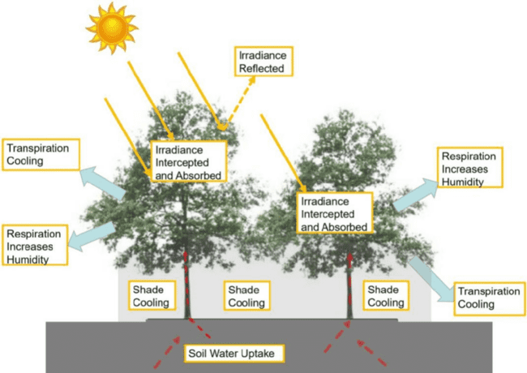
Cooling benefits from large canopy trees
Large trees with expansive leaf areas provide significantly higher temperature reductions compared to smaller trees.
Their ability to do the following makes them the most effective option for mitigating urban heat:
Provide shade
Intercept solar radiation
Cool the surrounding air through transpiration
Cooling Effect of trees
Source: Link

Slide 5
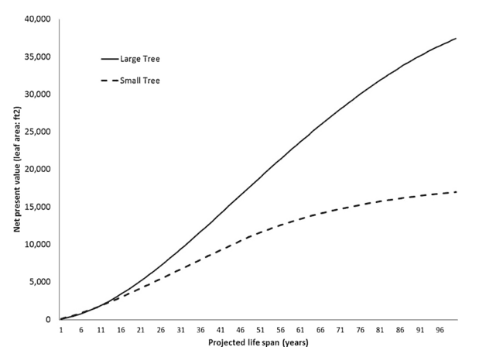
Financial Feasibility Through Long-Term ROI
While large trees require higher initial costs, their net present value (NPV) in terms of environmental and social benefits far exceeds that of smaller trees [1].
Large trees contribute the following:
Greater cumulative cooling,
Carbon sequestration, and
Pollution reduction benefits over their lifespan, providing a higher return on investment​
Net present value of one-inch (2.54 cm) dbh tree (large vs. small) based on projected life span of the one-inch tree.
Source: link

Slide 6
How to determine the functional value of a tree?
The functional value is an annual value based on the functions of the structure.
To compute this value, we must consider the following [1]:
Total leaf area (i.e., healthy canopy size)
Tree Life Span
Growth Rates
trunk diameter growth rate of 0.2 in/year
Discount rates of future services
Net Present Value was calculated as the following:
Note: Trees can have negative functional values when the wrong tree is put in the wrong site.
Trees can increase annual building energy use in certain locations, tree pollen can create allergic reactions
i = year beyond present year (present year = 1),
n = number of future years, LAi = leaf area in year i
rate = discount rate.

Slide 7
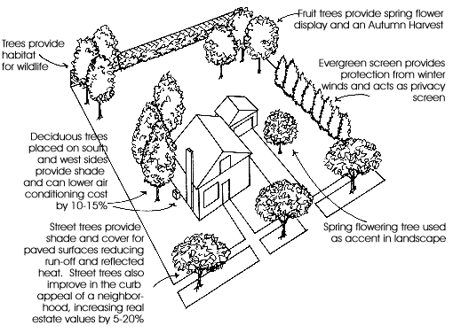
Strategic Placement Enhances Effectiveness
Locating trees on the southeast side of homes, as indicated in studies [1][4][5], maximizes energy savings by reducing cooling costs during peak sunlight hours​.
Incorporating these trees along urban corridors and high-density areas further amplifies their impact by cooling hotspots and reducing energy demands.
Tree Placement
Source: Pinterest

Slide 8
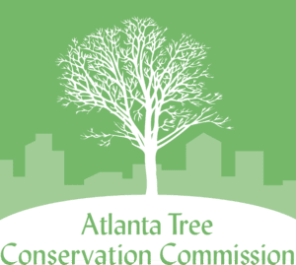
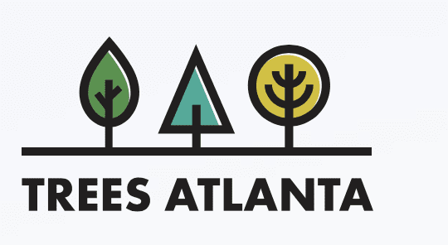
Community Engagement and Cost Sharing
Programs like Atlanta's Tree Trust Fund can support funding for tree planting and maintenance.
Maintenance for at least 3 years includes:
Watering
Mulching/ Weeding
Pruning
Public-private partnerships and tax incentives for residents to plant and care for trees on private property can further reduce municipal costs while fostering community buy-in

Slide 9
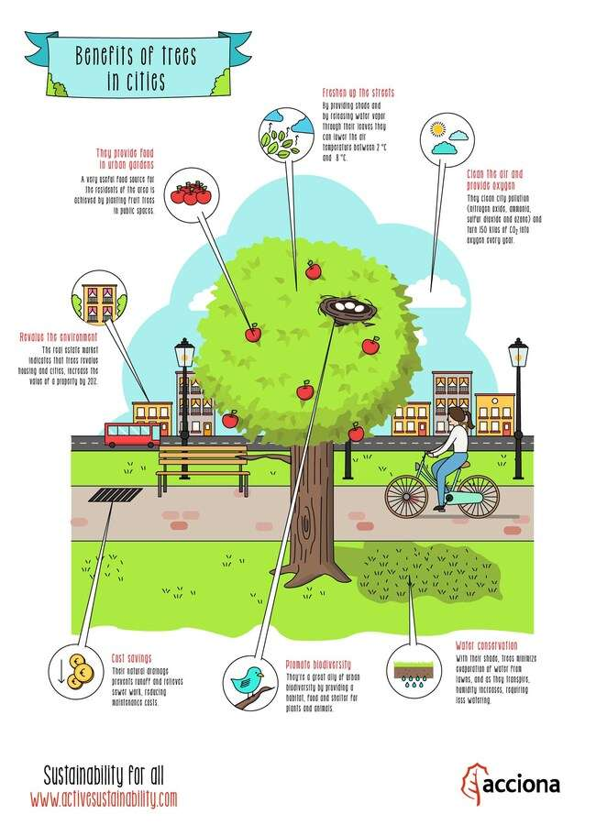
Sustainability of Large Tree Strategies
The long lifespan and resilience of large canopy trees ensure sustained benefits over decades. This aligns with findings that demonstrate their superior performance in delivering consistent cooling and ecosystem services​.
By transforming underutilized land into green spaces, the policy aligns with sustainable urban planning principles, fostering a balance between development and environmental conservation.
Benefits of Trees in Cities
Source: https://www.activesustainability.com/construction-and-urban-development/benefits-of-trees-in-cities/

Slide 10
Long-term benefits of having a large tree canopy in Atlanta
Improved quality of life
Economic Benefits
Environmental Resilience
Social Equity

Slide 11
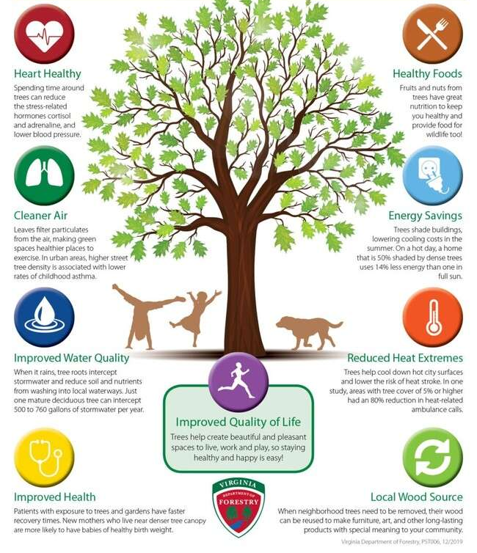
Having a large tree canopy will improve the quality of life for Atlanta residents
Cooling Urban Temperatures: Large-canopy trees provide shade and reduce surrounding air temperatures through transpiration, creating more comfortable environments for residents and visitors.
Health Benefits: Lower urban temperatures reduce heat-related illnesses and improve air quality by filtering pollutants, contributing to healthier communities.
Enhanced Public Spaces: Strategically placed trees make parks, sidewalks, and gathering spaces more inviting, encouraging outdoor activities and social engagement.
Improved quality of life with trees
Source: Google Images

Slide 12
Having a large tree canopy will have many economic benefits
Increased Property Values: Studies show that homes with mature trees on or near the property have significantly higher market values. The aesthetic and environmental benefits of large-canopy trees make neighborhoods more desirable.
Energy Savings: By shading buildings and cooling surrounding areas, large trees reduce energy consumption for air conditioning, lowering utility bills for residents and businesses.
Tree Placement
Source: Pinterest

Slide 13
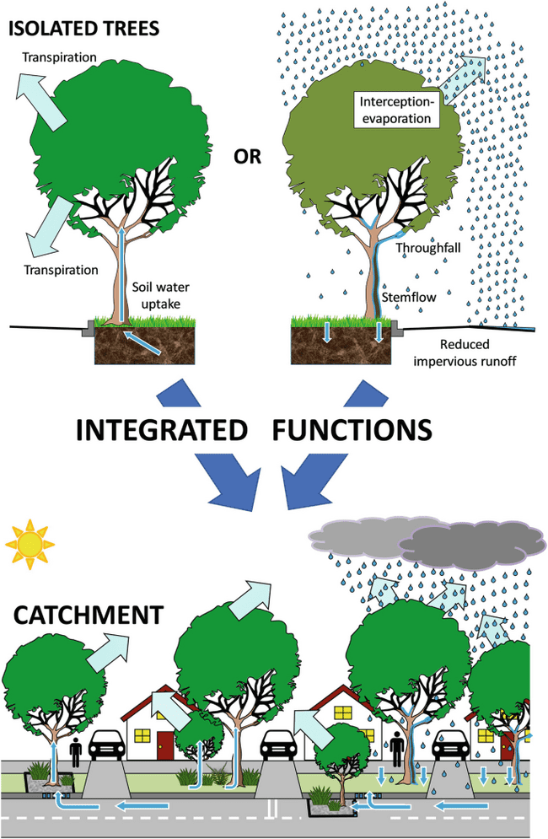
Having a large tree canopy will enhance environmental resilience
Carbon Sequestration: Large trees capture and store more carbon over their lifespan than smaller species, helping mitigate climate change.
Stormwater Management: Their extensive root systems improve soil absorption and reduce runoff, minimizing the risk of flooding in urban areas.
Urban Trees as Green Infrastructure for Stormwater management
Source: Stringerlink

Slide 14
Having a large tree canopy will promote social equity
Cooling Disadvantaged Areas: Targeting heat-vulnerable neighborhoods for tree planting ensures that lower-income communities receive the benefits of improved air quality, reduced temperatures, and enhanced public spaces.
Community Engagement: Involving residents in tree-planting initiatives fosters a sense of ownership and pride, strengthening neighborhood cohesion.

Slide 15
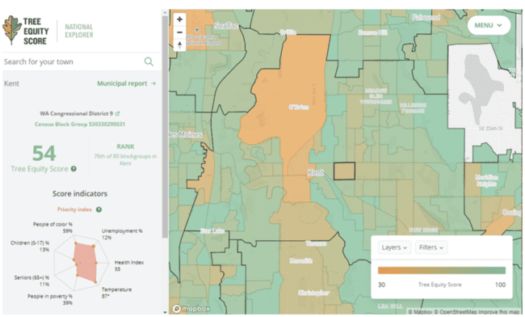
Steps to effectively implement the recommended policy
Hotspot Mapping and Prioritization:
Use thermal imaging to identify high-priority areas for tree planting, with a focus on vulnerable and underserved neighborhoods.
Incentives for Participation:
Offer tree delivery and establishment services, maintenance services, and tax credits to property owners who are interest in planting trees and/or maintain large-canopy trees, encouraging widespread adoption.
Arborist Recommendation:
When residents submit their request to have large trees removed, along with their conducting an evaluation of the tree, arborist will provide a recommendation on replacing the tree along with detail on the best placement of the new tree.
Public-Private Partnerships:
Collaborate with organizations like Trees Atlanta, local businesses, and universities to fund tree planting and maintenance programs.
Long-Term Maintenance and Education:
Establish a city-funded maintenance program to ensure trees thrive, paired with educational campaigns on the long-term benefits of urban greening.
Tree Equity Score in Neighborhoods throughout a city/ town
Source: https://www.washingtonnature.org/fieldnotes/2021/9/24/new-tools-for-urban-trees
Notes:
Add the arborists recommend if the tree should be replaced and give a location for replacement

Slide 16
Conclusion
This policy not only addresses the immediate challenge of urban heat but also creates cascading benefits that enhance the city’s livability, economic stability, and environmental resilience. By investing in large-canopy trees, Atlanta can transform its urban landscape into a cooler, greener, and more equitable environment, ensuring sustained improvements to quality of life and property values for generations to come.

Slide 17
References
David J. Nowak, Tim Aevermann, Tree compensation rates: Compensating for the loss of future tree values, Urban Forestry & Urban Greening, Volume 41, 2019, Pages 93-103
https://www.springfieldmo.gov/2074/Trees-Grounds
https://www.washingtonnature.org/fieldnotes/2021/9/24/new-tools-for-urban-trees
https://www.edmondok.gov/DocumentCenter/View/740/Benefits-of-Strategic-Tree-Placement#:~:text=Reduce%20summer%20air%20conditioning%20costs,trees%20need%20space%20to%20grow.
Abdulrazzaq Shaamala, Tan Yigitcanlar, Alireza Nili, Dan Nyandega, Strategic tree placement for urban cooling: A novel optimisation approach for desired microclimate outcomes, Urban Climate, Volume 56, 2024

